Slide 1
Managing Project and Teams
Lecture 11: Stakeholder Analysis and Management

Slide 2
Retrospection
Leading a project team
Making team decisions
Sources of power
Importance in understanding power sources
Notes:
Managing project scope, quality, and responsibility are critical components of project management, ensuring that projects are delivered successfully, meet stakeholder expectations, and achieve their intended outcomes.

Slide 3
Key topics covered in this lecture

Slide 4
What we will cover in this lecture
By the end of the lesson, students should be able to:
Understanding the origins of stakeholder concepts in projects
Define stakeholder
List steps in identifying stakeholders
Techniques in stakeholder prioritisation
Discuss ways to manage stakeholders

Slide 5

If you are employed and your father, manager, friend, partner, sports coach, and religious or traditional leader all want to meet you at 10am on the same day during the week, which meeting would you prioritize?
ⓘ Start presenting to display the poll results on this slide.

Slide 6
Defining stakeholder
A stakeholder is an individual, group, or organization that may affect, be affected by, or perceive itself to be affected by a decision, activity, or outcome of a project (Freeman,1984).
A stakeholder refers to any individual or group that maintains a stake in an organisation in the way that a shareholder possesses shares (Fassin, 2009).
the internal constituents
Stakeholders, Stakekeepers e.g unions, Stakewatchers e.g compliance bodies.
Project stakeholders may be internal or external to the project, they may be actively involved, passively involved, or unaware of the project.
Notes:
Project stakeholders may have a positive or negative impact on the project, or be positively or negatively impacted by the project.
The project charter identifies the key stakeholder list and may also contain information about the responsibilities of the stakeholders.

Slide 7
Origins of stakeholder concepts
Great Depression in the United States (1929-1941), when the General Electric Company defined four major stakeholder groups - shareholders, employees, customers, and the general public (Preston,1999) .
Freeman links it to studies at Stanford University in 1963 referring stakeholders as those groups without whose support the organisation would not survive (Mishra, and Mishra, 2013)
Stakeholder Theory (1990s-2000)
Integration into Business Practice (2000s-Present)

Slide 8
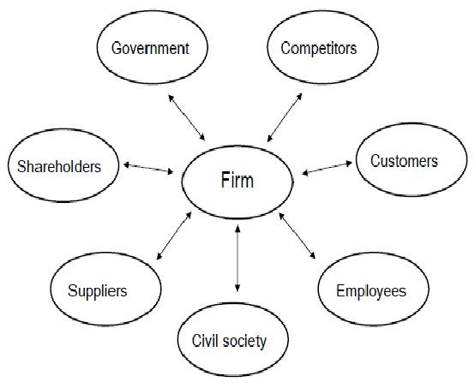
Evolution of stakeholder concepts
Freeman 1984 first identified eleven and then later seven players on the stakeholder model
Shareholder activism and promoting social justice
Compliance bodies
Equity, Diversity and Inclusivity

Slide 9
Revised Stakeholder Model
There are clear ambiguities in basic concepts of the stakeholder model, the stakeholder theory, the stakeholder approach, stakeholder analysis and stakeholder management (Fassin, 2009).

Slide 10

Identify stakeholders of a university
ⓘ Start presenting to display the poll results on this slide.

Slide 11
Stakeholder Theory
Stakeholder theory is a management concept that suggests businesses and organizations should consider the interests of all stakeholders affected by their decisions and actions, rather than solely focusing on maximizing profits for shareholders (Wagner, Alves and Raposo, 2012) .
Stakeholder theory is about managing potential conflict stemming from divergent interests.
Stakeholders who are strategically important should be managed as partners (Fassin, 2009).
Stakeholder theory draws on four of the social sciences: sociology, economics, politics and ethics, corporate social responsibility and organisational studies.

Slide 12
Examples of stakeholders
Internal Stakeholders
Sponsor
Portfolio steering committee
Team members
Resource Manager
External stakeholders
Customers
End users
Suppliers
Shareholders
Regulatory bodies
Competitors
Notes:
Project stakeholders may have a positive or negative impact on the project, or be positively or negatively impacted by the project.
The project charter identifies the key stakeholder list and may also contain information about the responsibilities of the stakeholders.

Slide 13
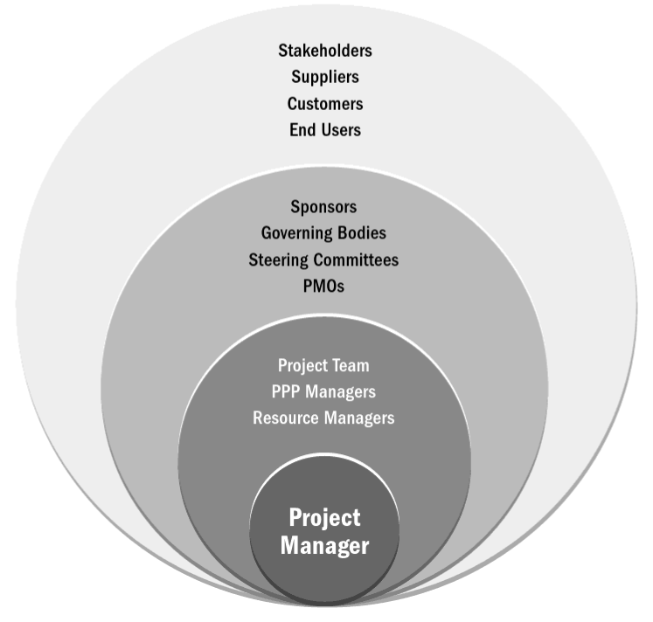
Examples of Project Stakeholders
Notes:
The type and level of project involvement can change over the course of the project’s life cycle.
Therefore, successfully identifying, analysing, and engaging stakeholders and effectively managing their project expectations and participation throughout the project life cycle is critical to project success.

Slide 14
Key questions stakeholders should answer
What does success look like for this project?
How will success be measured?
What factors may impact success?

Slide 15
Challenges in Identifying Stakeholders
Incomplete Information
Hidden Stakeholders
Changing Dynamics
Conflicting Perspectives
Stakeholder Bias
Resource Constraints
Notes:
Incomplete Information: It can be difficult to gather comprehensive information about all potential stakeholders.
Hidden Stakeholders: Some stakeholders may not be obvious .

Slide 16
So how do we identify the stakeholders?
Who are the sponsors, customers, users, suppliers, employers interested or affected
Who is (people/organisations/systems) affected by the project?
Which processes are affected?
Competitors/creditors/authorities interested
Power/Legitimacy/ Urgency, Proximity/ Interest

Slide 17
Stakeholder Analysis
Stakeholder analysis is a process of systematically gathering and analysing information to determine whose interests should be taken into account when developing and/or implementing a policy or program.
Two methods of performing analysis
Stakeholder circle
Organisational Zoo concept (Walker, Bourne and Shelley, 2008).

Slide 18
Stakeholder Circle
Identify stakeholders: Project team brainstorming is recommended in order to ensure that all relevant stakeholders are captured and recorded.
Prioritisation
Interest ranking: Rank all identified stakeholders in terms of the perceived level of interest of each stakeholder.
Power ranking: Rank all identified stakeholders in terms of the power to affect the outcome of (or otherwise interfere with) the project.
Visualise
Engage stakeholders
Monitor effective communicationUnderstand

Slide 19
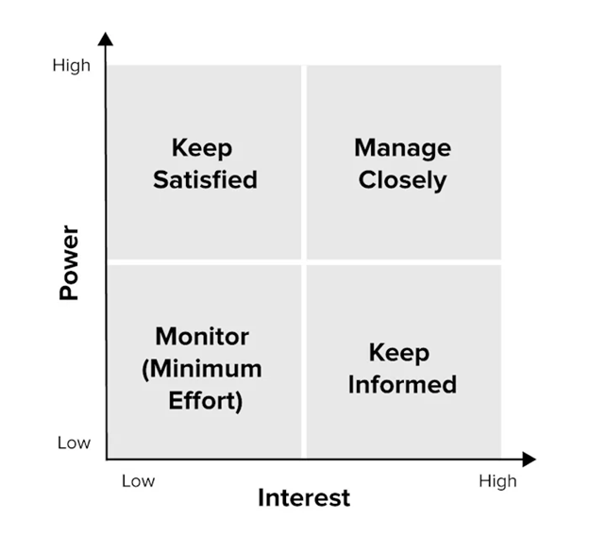
Stakeholder Prioritisation
Power-interest grid

Slide 20
Organisational Zoo Concept
It’s a metaphorical approach
Helps project teams to engage with a client’s end-user team to identify ‘lead users’ who can influence effective knowledge transfer of post-project operational and maintenance activities.
Lions- assertive stakeholders
Elephants- Steady Stakeholders
Dolphins- Collaborative Stakeholders
Turtle- Resistant Stakeholders
This can be used when identify the characters of stakeholders.

Slide 21

There are eight major steps in the process
1. Planning the process
2. Selecting and defining a policy
3. Identifying key stakeholders
4. Adapting the tools
5. Collecting and recording the information
6. Filling in the stakeholder table
7. Analysing the stakeholder table
8. Using the information

Slide 22
Outputs from Stakeholder Analysis
There are two practical outcomes of the stakeholder analysis process.
stakeholder register- list order of importance
stakeholder analysis process- depicts power and interest

Slide 23
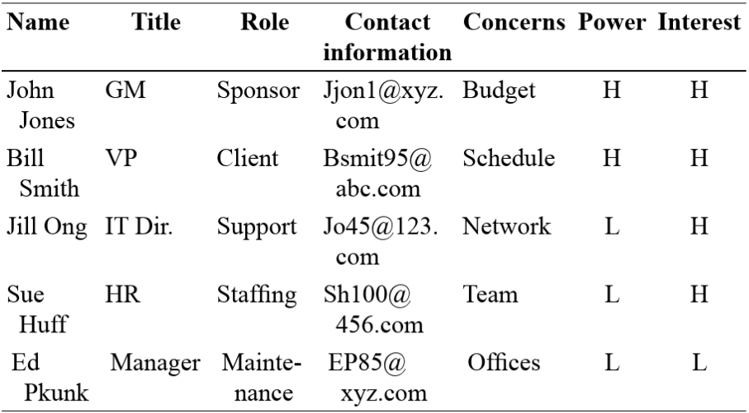
Example of Stakeholder register

Slide 24
Stakeholder Engagement Levels
Leading
Supportive
Neutral
Resistant
Unaware

Slide 25
Controlling Stakeholder Engagement
Can you control stakeholders?
Notes:
You can not control them but rather level of engagement.

Slide 26
Ways to Control Engagement
Participation in kick-off meetings
Meet before hand with key stakeholders
Engagement activities and deliverables throughout the project
Stakeholders As Key Project Team Members
On some IT projects, important stakeholders are invited to be members of the project teams (Example: Northwest Airlines and ResNet)

Slide 27
Stakeholder Management: Best Practice
Build Trust and Relationships
1
Engage continuously
2
Customise communication
3
Address Stakeholder needs and satisfaction
4
Manage expectations
5
Notes:
Best practices, organizations can effectively manage stakeholder relationships, enhance stakeholder engagement, and maximize project success.

Slide 28
Stakeholder Management: Best Practise
Build Trust and Relationships
Engage continuously
Customise communication
Address Stakeholder needs and satisfaction
Manage expectations

Slide 29
Summary

Slide 30
What are the key takeaways from this lecture?
ⓘ Start presenting to display the poll results on this slide.

Slide 31
Next Lesson
Emerging trends in managing projects and teams
Ethics and compliance in managing projects and teams
Future of managing projects and teams. [AI, Machine Learning]
Possible research areas in managing projects and teams

Slide 32
References
Fassin, Y., 2009. The stakeholder model refined. Journal of business ethics, 84, pp.113-135.
Freeman, R. (1984), Strategic Management: A Stakeholder’s Approach, Pitman, Boston, MA.
Mishra, A. and Mishra, D., 2013. Applications of stakeholder theory in information systems and technology. Engineering Economics, 24(3), pp.254-266.
Guide, P.M.B.O.K., (2017). A Guide to the Project Management Body of Knowledge (PMBOK® Guide), Project Management Institute.
Marion, James W.. Project Management : A Common Sense Guide to the PMBOK, Part One-Framework and Schedule, Momentum Press, 2018. ProQuest Ebook Central, http://ebookcentral.proquest.com/lib/ucsl/detail.action?docID=5264990. Created from ucsl on 2024-02-22 20:40:15.
Murray, A.P., 2016. The Complete Software Project Manager: Mastering Technology from Planning to Launch and Beyond. John Wiley & Sons.
Verzuh, E., 2015. The fast forward MBA in project management. John Wiley & Sons.
Wagner Mainardes, E., Alves, H. and Raposo, M., 2012. A model for stakeholder classification and stakeholder relationships. Management decision, 50(10), pp.1861-1879.
Walker, D.H., Bourne, L.M. and Shelley, A., 2008. Influence, stakeholder mapping and visualization. Construction management and economics, 26(6), pp.645-658.
Ward, G.G., 2018. Effective project management: guidance and checklists for engineering and construction. John Wiley & Sons.

